Slide 1
Paper critique
The role of direct air capture and negative emissions technologies in the shared socioeconomic pathways towards +1.5 ◦C and +2 ◦C futures
(Fuhrman et al. 2021.)
ITM 20235575, Jiseok AHN

Slide 2
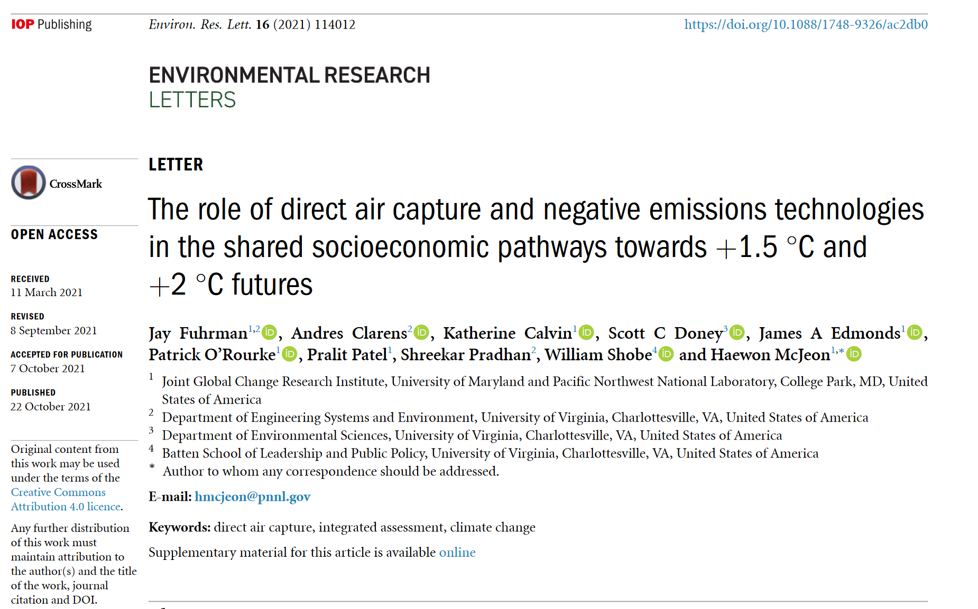
Table of contents
Introduction
Methods
Results
Summary of the key findings
Critique

Slide 3
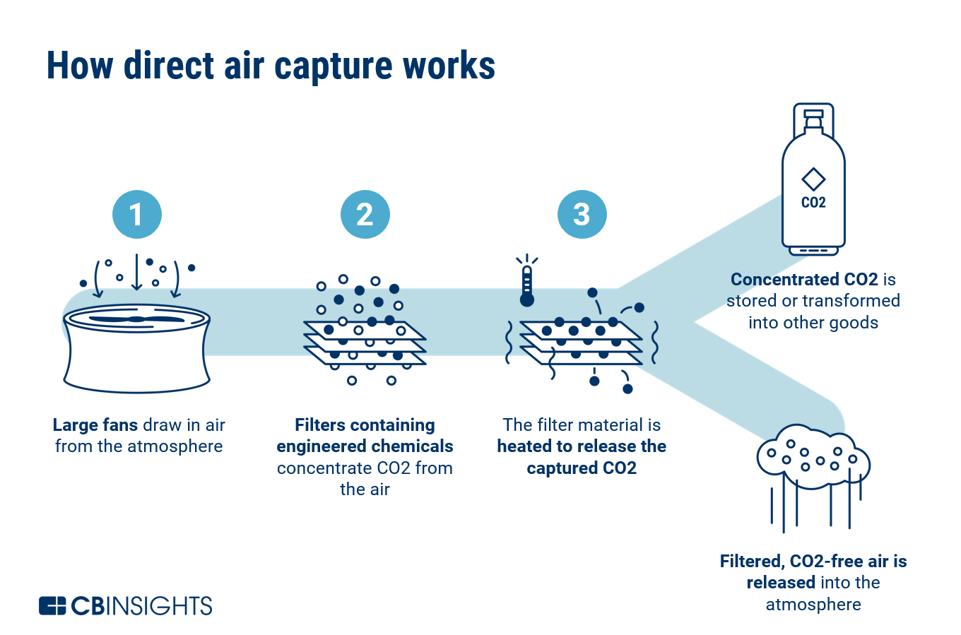
Introduction
DACCS as a viable negative emission technology
Several forms of direct air capture with carbon storage (DACCS) are in development, with different costs and energy inputs, as well as potential for future cost and performance improvements.
Recent progress in DACCS commercialization suggests it could be a viable means of removing CO2 in the near future.
DACCS has the advantage of lower land intensity than bioenergy with carbon capture or afforestation but requires higher energy demands.

Slide 4
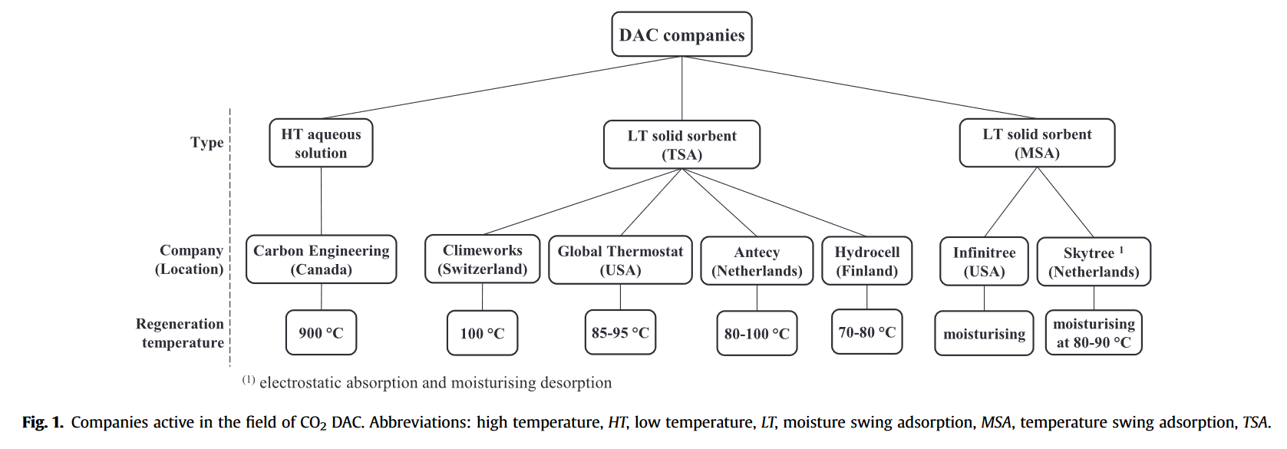
Methods
Two types of DACCS technology are considered in GCAM 5.4
Assess the high-temperature DACCS process that uses heat from natural gas combustion, electricity, and water could contribute to both ambitious near-term and delayed mitigation scenarios that limit end-of century warming to below +1.5 ◦C.
For low-temperature DACCS, this study converted the required low-temperature thermal energy to electricity by assuming an electric compression heat pump plant with a coefficient of performance equal to 3 and accounted for its additional levelized financial input.
Fasihi et al (2019)
Notes:
Exogenous treatment of GCAM allows sensitivity analysis of cost or efficiency targets for different technologries.

Slide 5
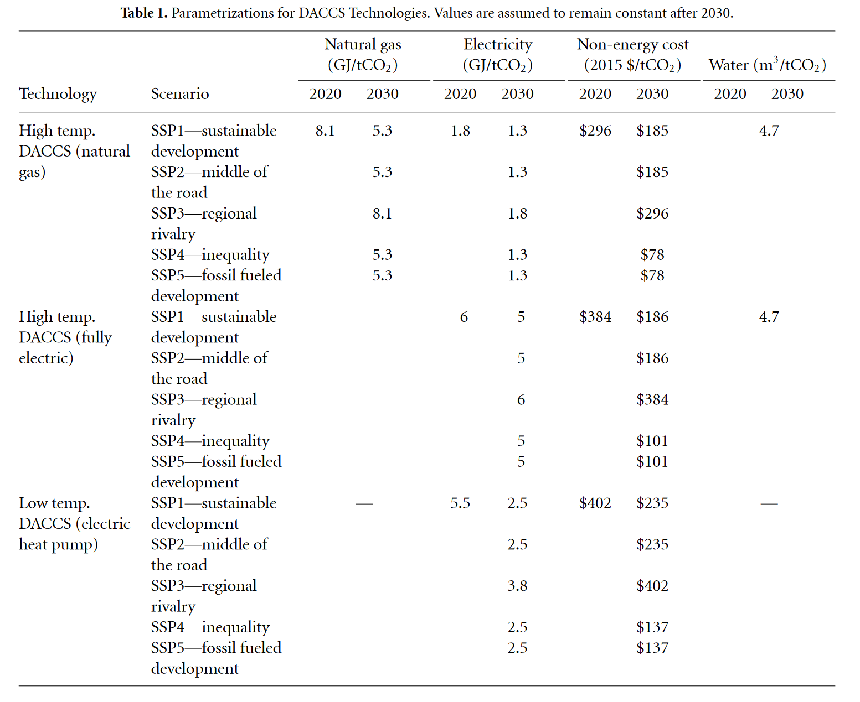
Methods
Parametrizations for DACCS technologies
This paper uses GCAM to understand the role of DACCS across all 5 SSPs for the below 2 ◦C and below 1.5 ◦C end-of-century warming goals.
For parametrizations, generally follow the detailed methodology of Fasihi et al (2019).

Slide 6
Results
Main results
DACCS could play up to tens of GtCO2 yr−1 role in many of these scenarios, particularly those with delayed climate policy and/or higher challenges to emissions mitigation.
Provides 4 different results for different SSP scenarios and target temperature goals.
- Positive and negative CO2 emissions by sector
- Primary energy consumption
- Global land use
- Water use

Slide 7
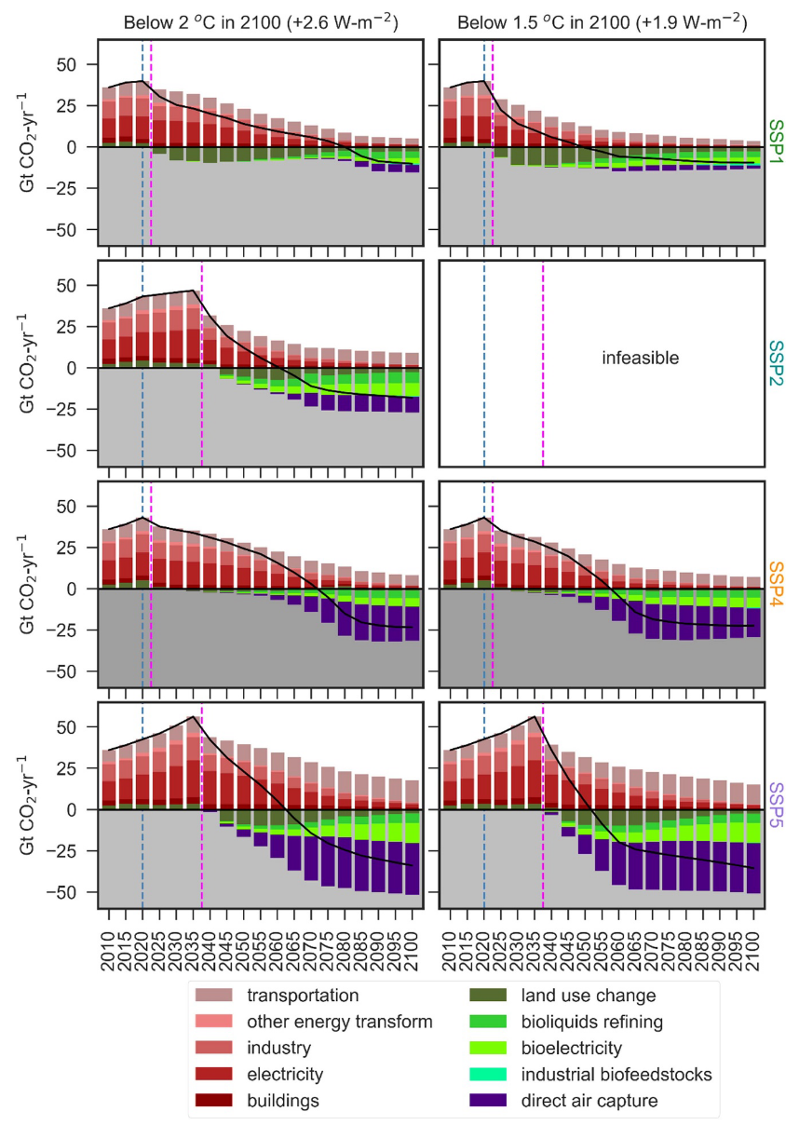
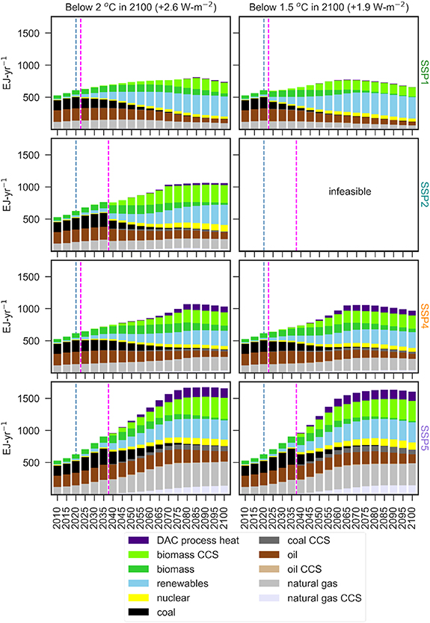
Results
Positive and negative CO2 emissions by sector
Primary energy consumption

Slide 8
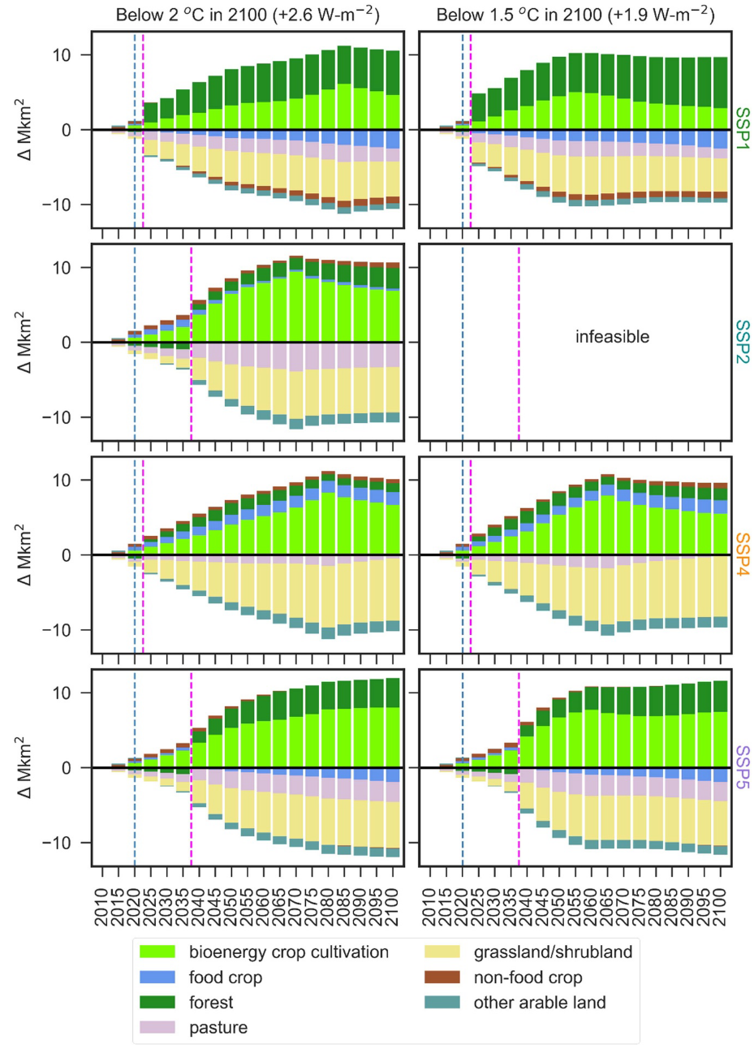
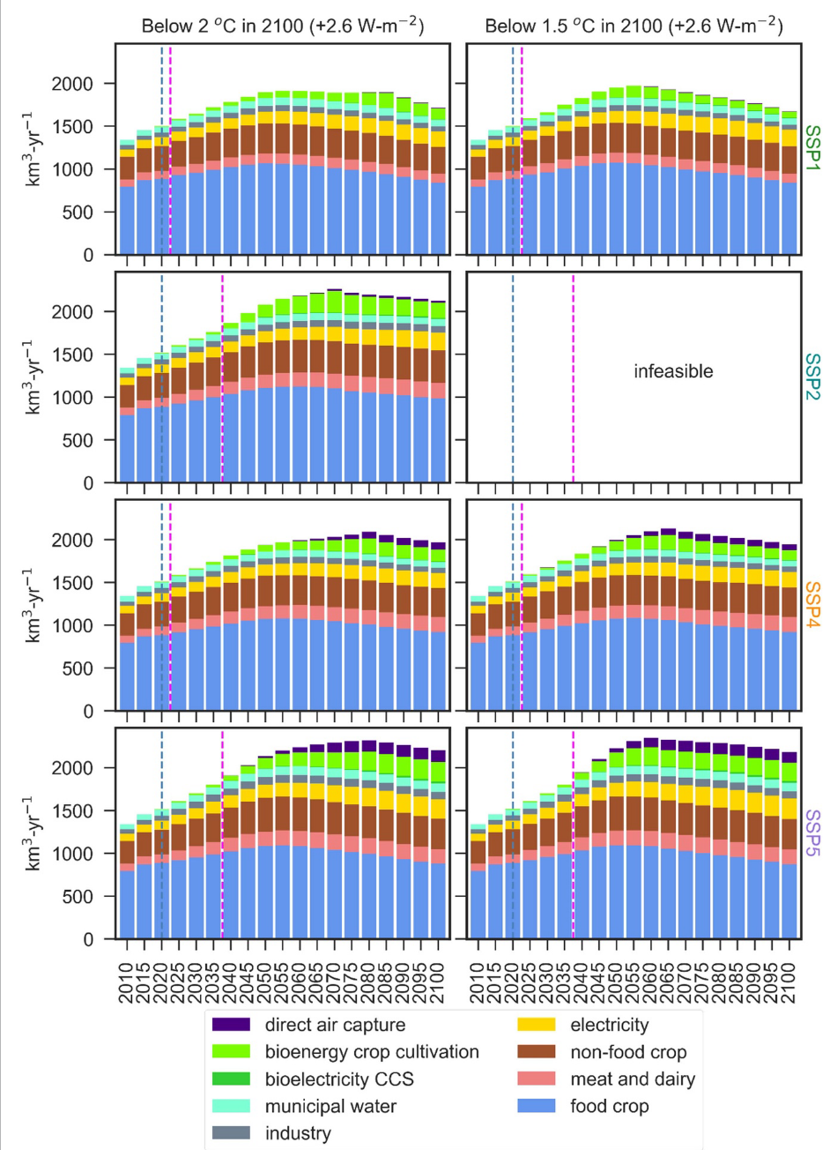
Results
Global land use
Water consumption

Slide 9
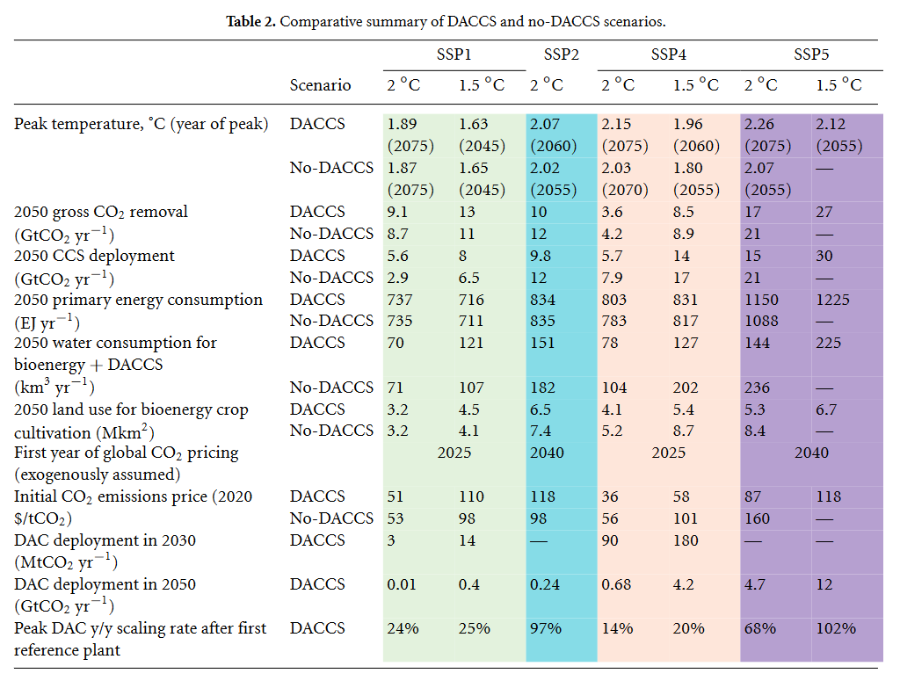
Summary of the key findings
Comparative summary
The SSP1- 1.5 ◦C -DACCS scenario shows the least overshoot of the +1.5 ◦C goal.
DACCS could play a large role in mitigation and reduce the sharpest tradeoffs of land and irrigation-intensive negative emissions deployments.

Slide 10
Summary of the key findings
Strengthened near-term policy ambition is needed
SSP1 scenario is the only one of the below +2 ̊ C scenarios that did not temporarily overshoot this warming target, and all scenarios temporarily overshot the +1.5 ̊ C target.
This highlights the importance of strengthened near-term policy ambition in case negative emissions prove unable to scale up quickly enough to reverse the overshoot of a less ambitious goal.
Given the emerging emphasis on DACCS in deep negative emissions scenarios, this study propose that the IAM community more fully integrate DACCS into future SSP scenarios such that opportunities to reduce reliance on future negative emissions can be highlighted.

Slide 11
Critique
I suggest 3 strengths and 1 weakness of this research as critique
Comparative summary allows us to see clearly the main results of the research.
The data that support the findings of this study are available online, so GCAM modeler and other IAM communities can easily access the configuration of the analysis.
Urge people to avoid the risks of delaying mitigation policies and thus further deepening the reliance on large-scale negative emissions, or else failing to meeting the goals of the Paris Agreement.
Some figures can be stylistically improved, such as a color scheme for legend properties or using different plots to show what the authors want to point out.

Slide 12
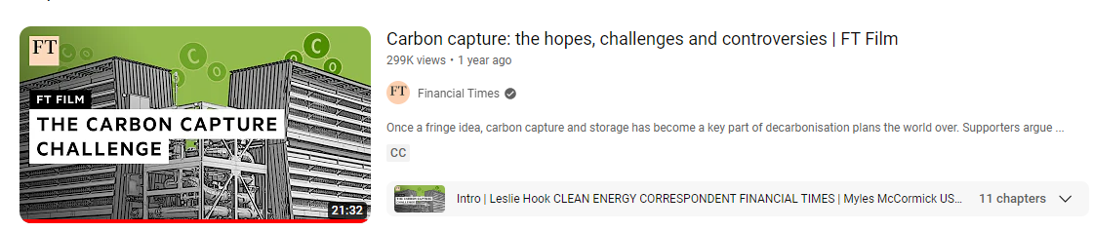
Thank you for listening
For those who wants know more about carbon capture

